Slide 1
ELTE Faculty of Humanities Library

Slide 2
- 48 separate library units in total
- Organized into 7 specialized libraries
- Work as 1 cooperating organization
- Called ELTE Faculty of Humanities Library
- Member libraries operate in seven buildings out of eight on the campus

Slide 3
Central Library
Library of Historical, Art History, Ethnography and Folklore Studies
Library of English-American and Germanic Studies
Library of East Asian and Oriental Studies
Library of Hungarian Linguistics, Literature and Studies of Philosophy
Library of Romance, Slavonic and Baltic Philology Studies
Library of Archaeological Sciences, Ancient and Classical Studies

Slide 4
- All ELTE citizens can use ELTE’s libraries FREE of charge after Registration (online/pers.)
- The librarians catalog, store, provide access to approx. 1,2 million pieces of library material (documents) in total

Slide 5
- Several of our collections are unique both nationally and internationally (private libraries, original prints and manuscripts of former professors and scholars)
- ELTE subscribes to several licensed web resources which provide access to thousands of journals and other research materials in the humanities (more than 100 subscriptions and available databases EBSCO, JSTORE, Cambridge University Press Journals, and Wiley Online Library etc.)

Slide 6
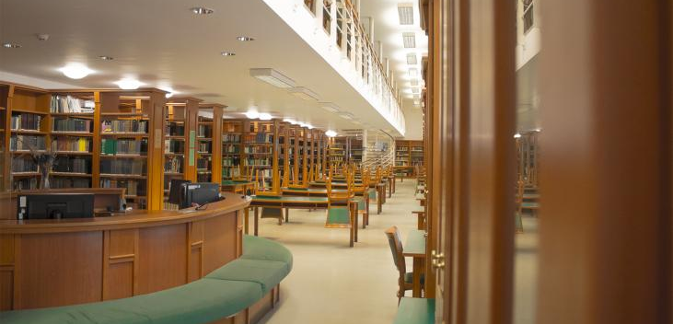
Central Library / Central Reading Hall (main building)

Slide 7
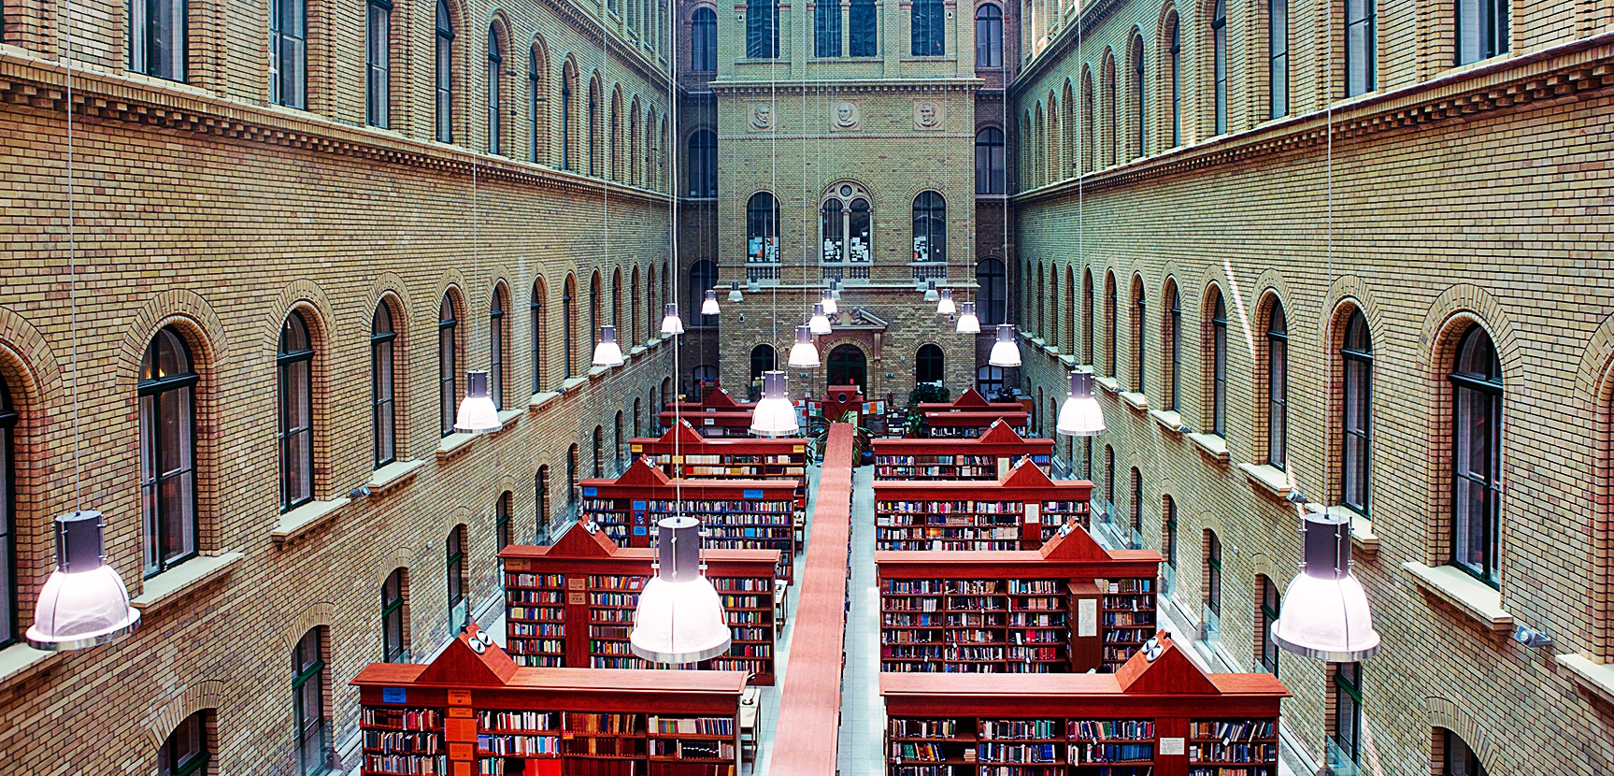
Library of English-American and Germanic Studies (main building)

Slide 8
- Active students of the Faculty of Humanities are eligible to borrow books from the libraries
- It is strictly forbidden to bring food and drink into the Libraries

Slide 9
- ELTEfind, the online public access catalogue for ELTE University libraries, is available on terminals within the Libraries, and remotely from home 24/7
- The catalogue indicates which libraries have each title as well as the availability of each copy of every title
http://opac.elte.hu (Click on English)

Slide 10
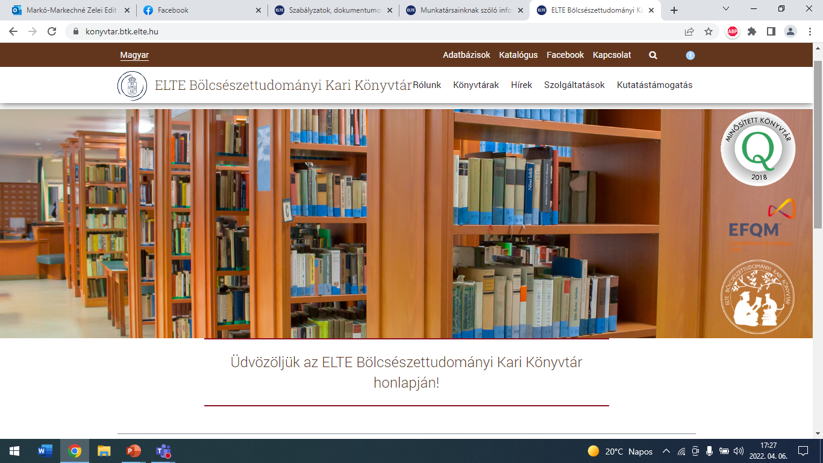
https://konyvtar.btk.elte.hu
11/09/23 new homepage

Slide 11
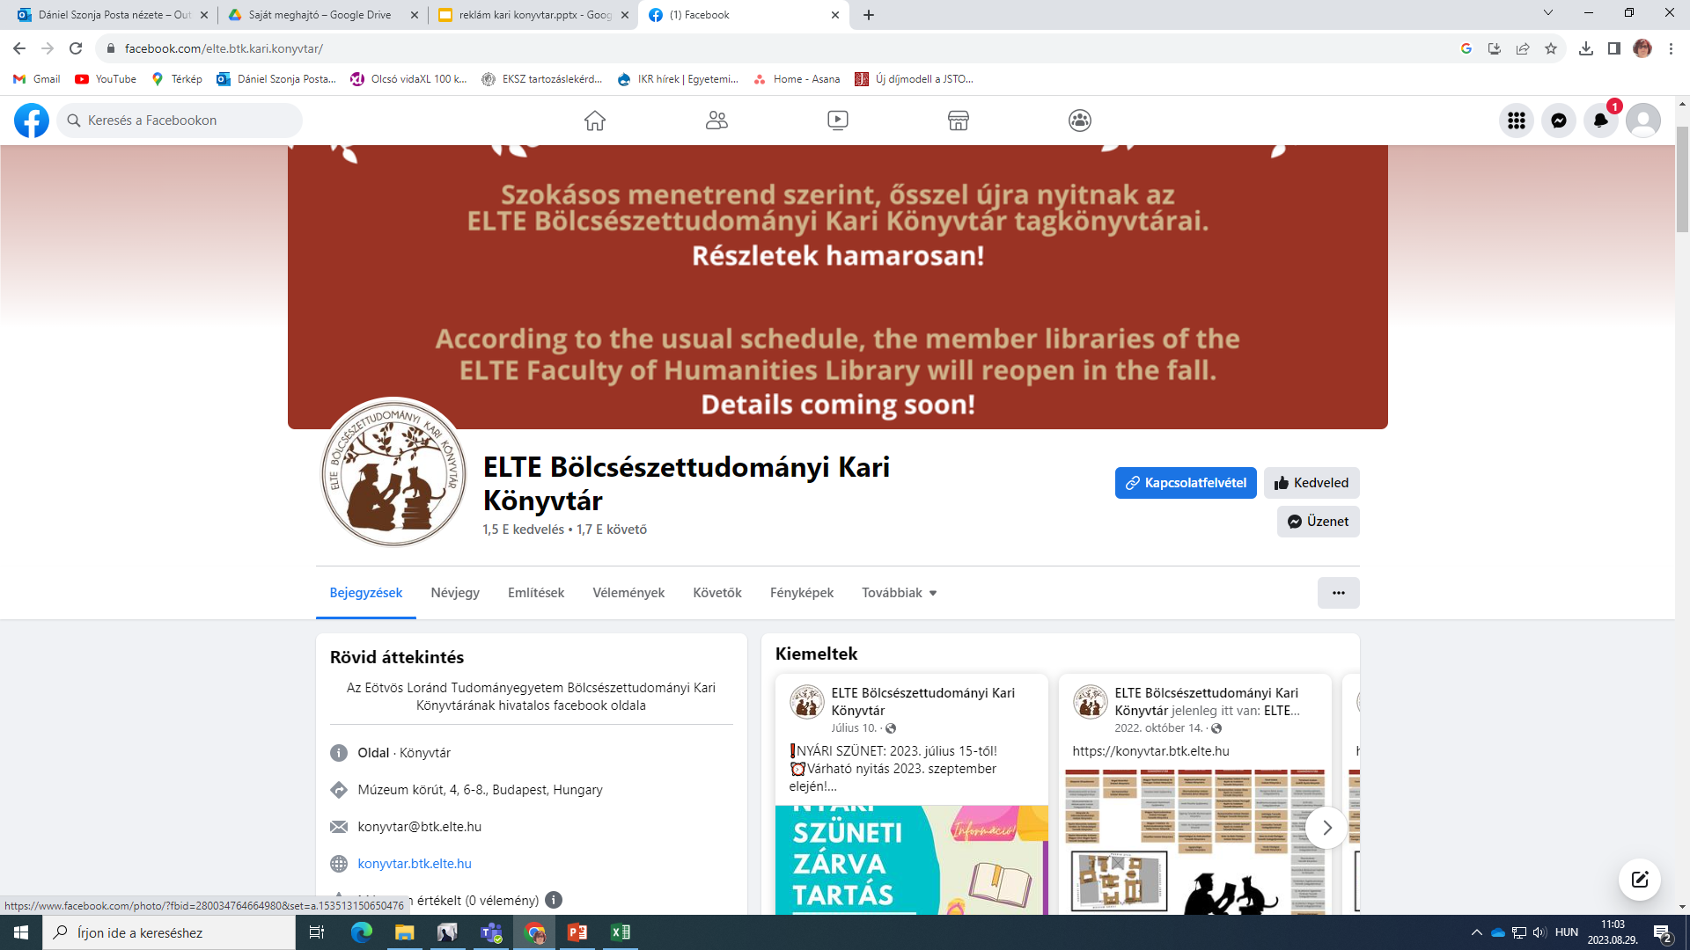
facebook.com/elte.btk.kari.konyvtar

Slide 12
Thank you for your attention!

