Slide 1
Studying abroad:
an adventure in transitioning
Dr. Uwe Pohl
Associate Professor, School of English and American Studies
Welcome and Information Days, 6 February 2024

Slide 2
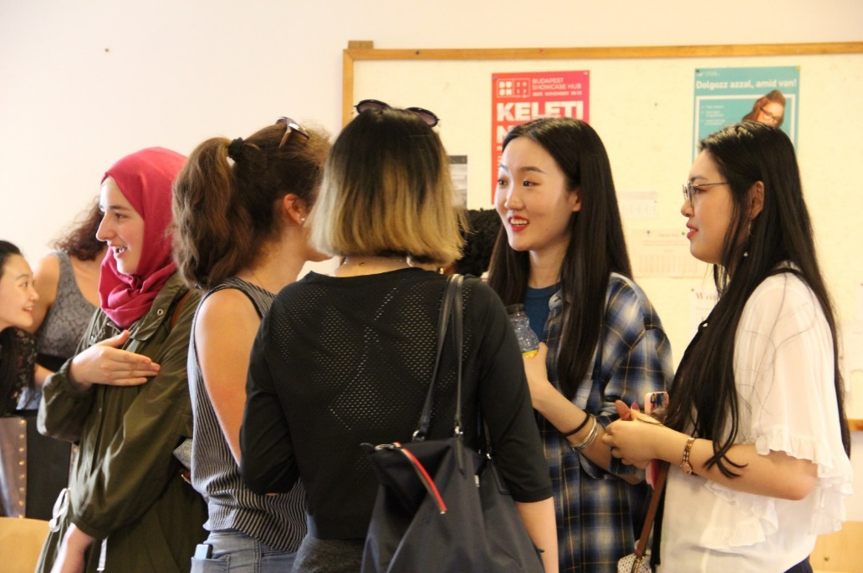
Welcome!
RENDEZVÉN, DÁTUM

Slide 3
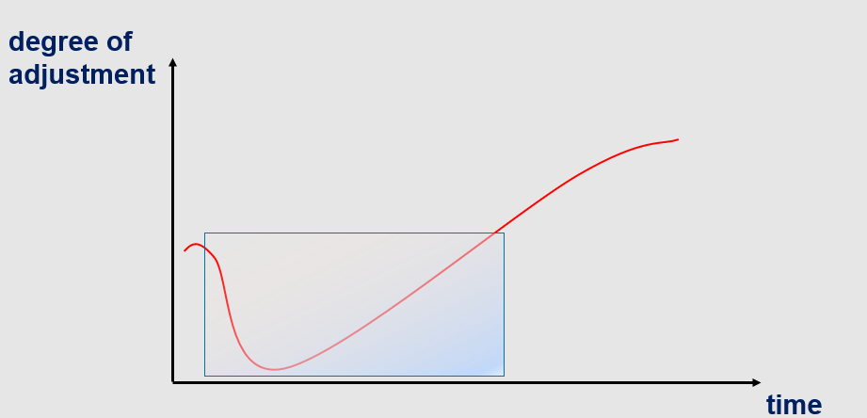
Transition experiences
Black, JS./Mendenhall, M. (1991) The U-Curve Adjustment Hypothesis Revisited: A Review and Theoretical Framework.
In: Journal of International Business Studies, Second Quarter.

Slide 4
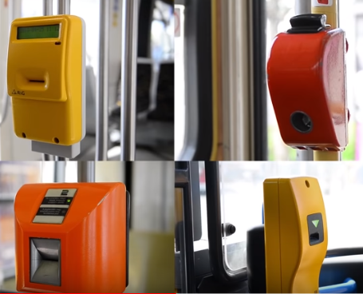
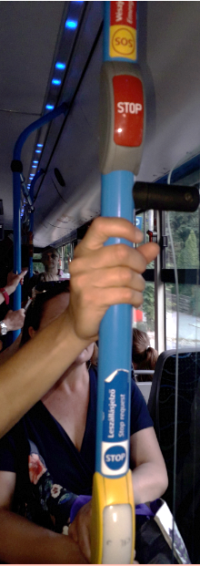
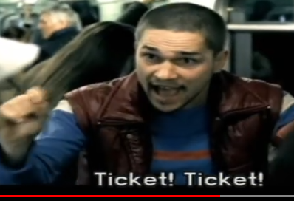
Budapest transport

Slide 5
Student perceptions
As someone who was new to the country and the city, everything seemed perfect at first and I was very excited. However, as I continued living here,
I couldn't help but see the bad sides of the whole thing.
What comes to my mind first is that after a certain time in the evening, like 7 or tops 9, everything closed, even the big shopping malls…
In my country everything is open until midnight or even after midnight.
So if I want to go buy or drink something at a cafe, I could go at 10 p.m. and it would still be open…
Gülden

Slide 6
Student perceptions
This was the first time that I stayed away from my home country.
The first thing I would like to mention is that we don't really plan a meeting.
When we want to visit someone's home, we just go to their home, either have lunch or dinner there, and you are very welcome. And if you do have a planned gathering, you will be asked to stay as long as you can.
Xiao

Slide 7
Transition shock
“the emotional and physiological reaction of
high activation
that is brought about by sudden immersion
in a new and different culture.”
LONELINESS
DESIRE FOR HOME
IRRITABILITY
HELPLESSNESS & WITHDRAWAL
EXCESSIVE CONCERNS
TIREDNESS
(Bennett, J.M.1998: 216)

Slide 8
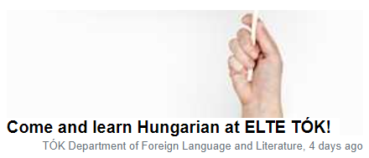
What helps you adapt?

Slide 9
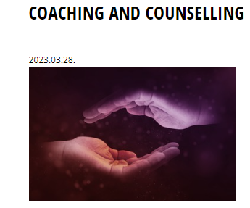
The university’s HELP network
HELP English-speaking local student mentors
help_coaching@btk.elte.hu
Notes:
BTK has its own psychologist – Hannah Szili, who overs counselling and psychological help on demand
Team of volunteer peer counsellors (MA students of psych)

Slide 10
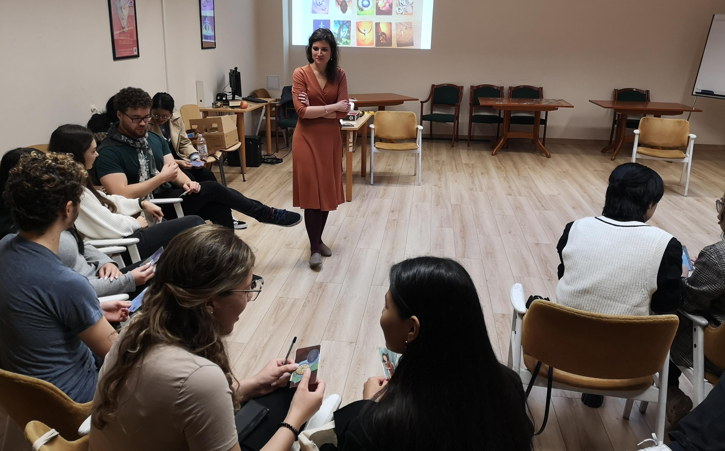
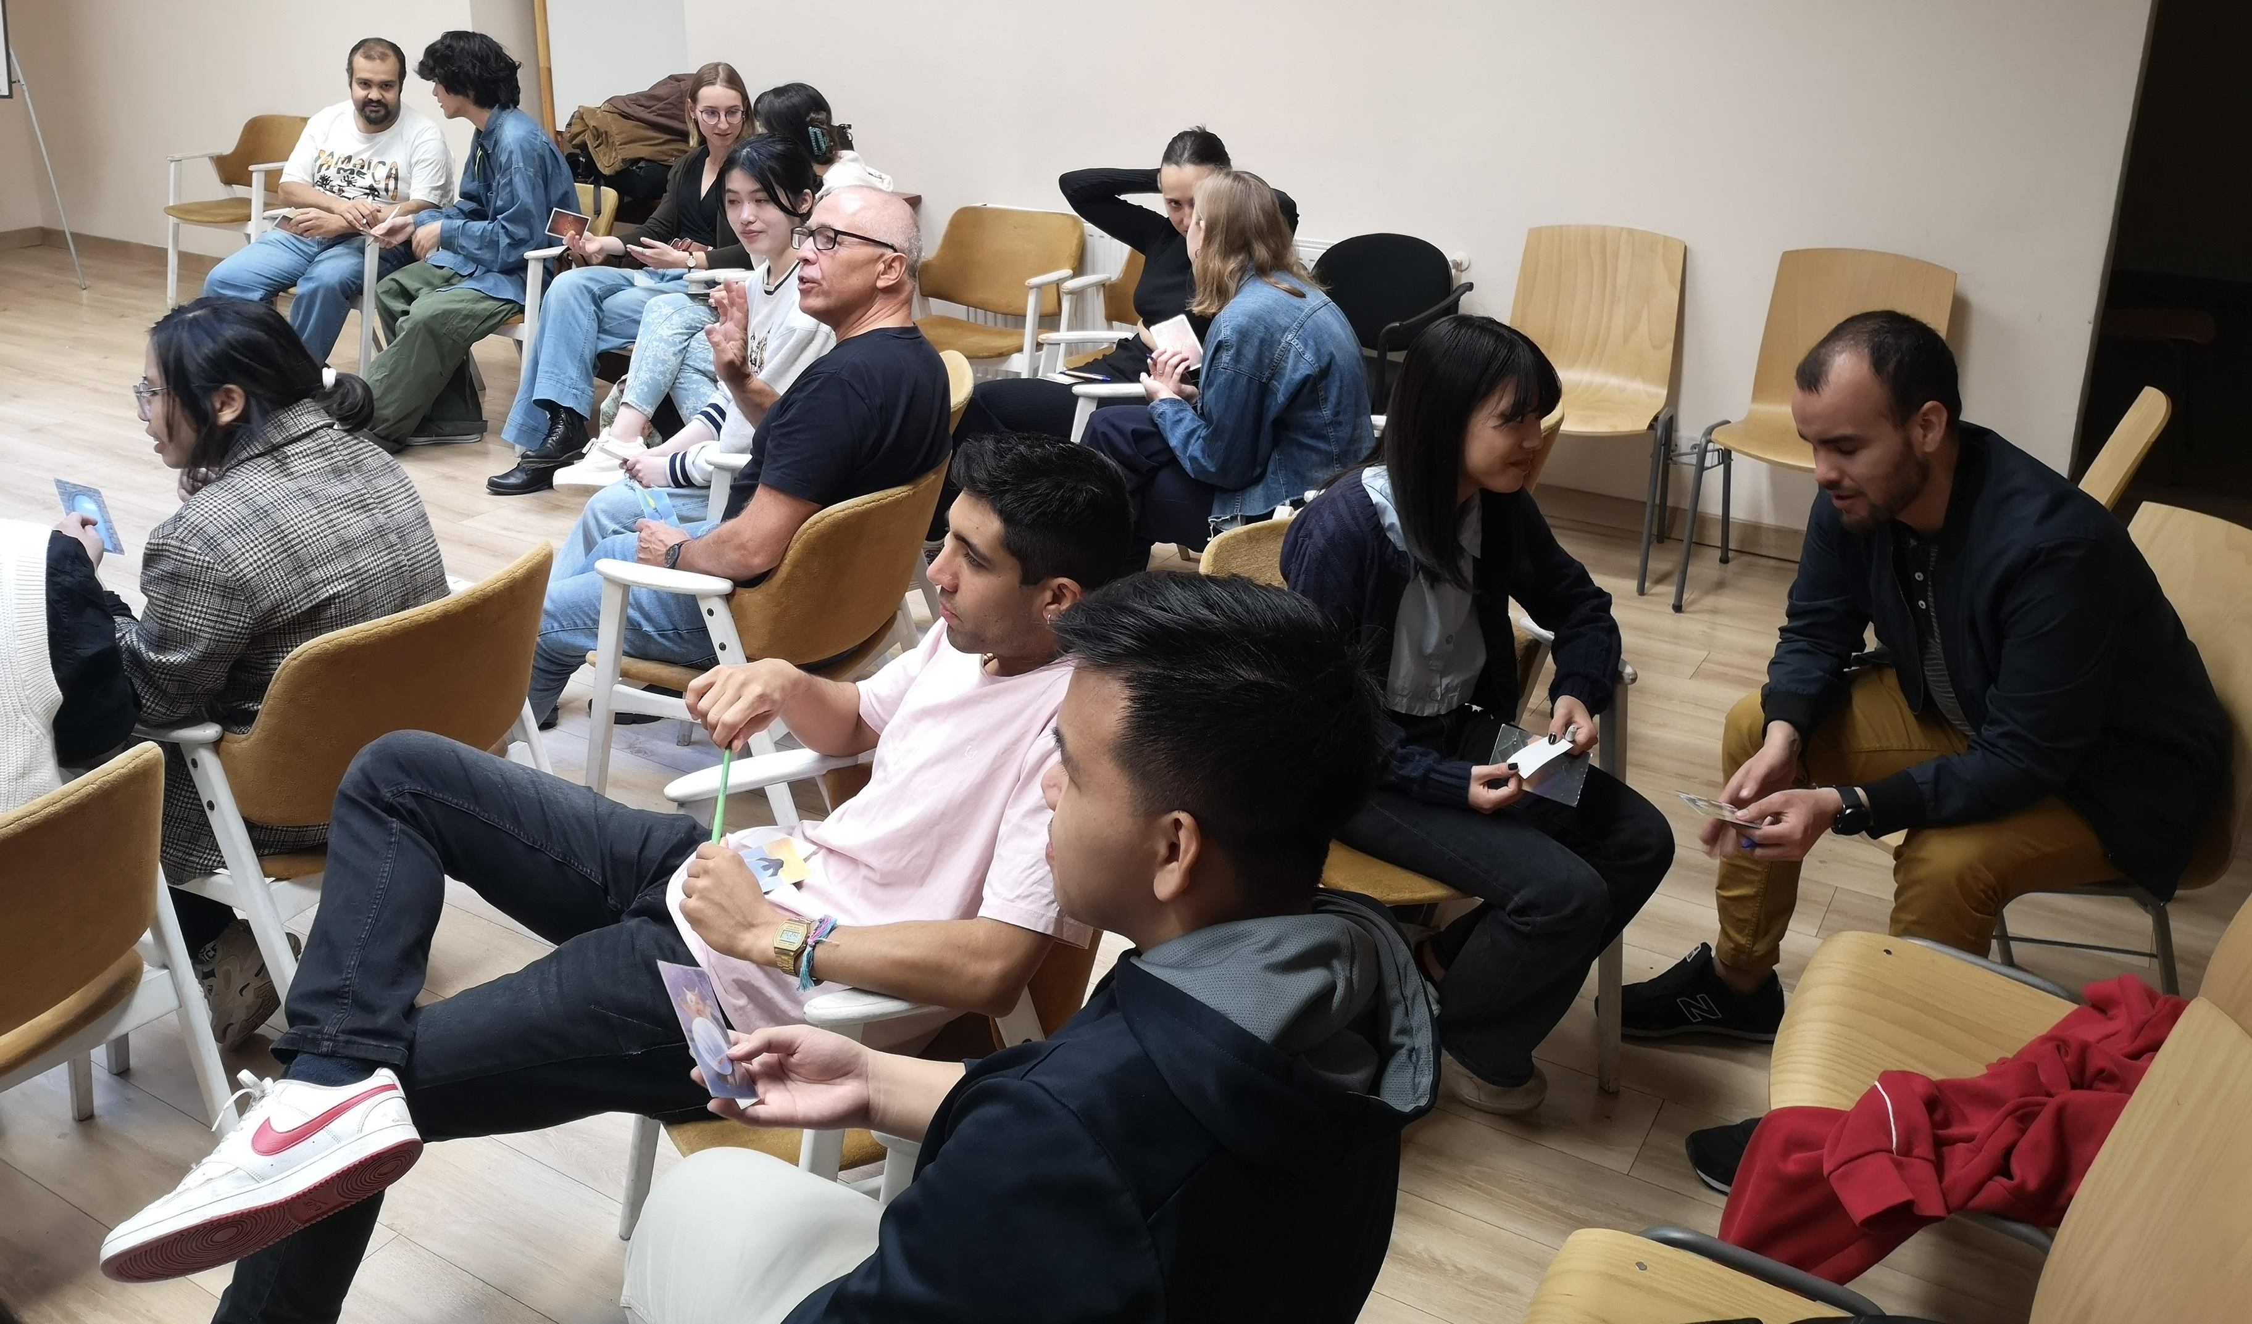
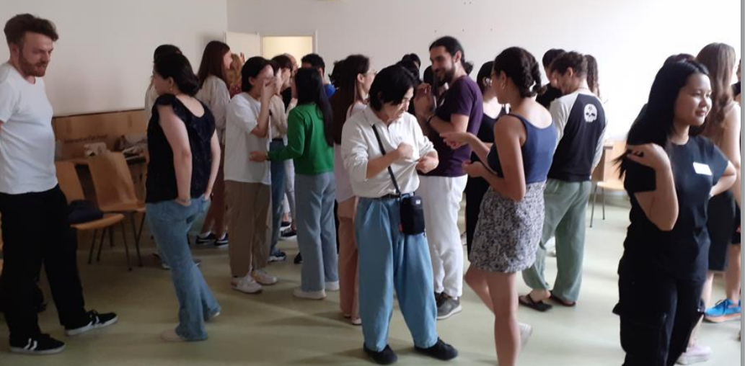
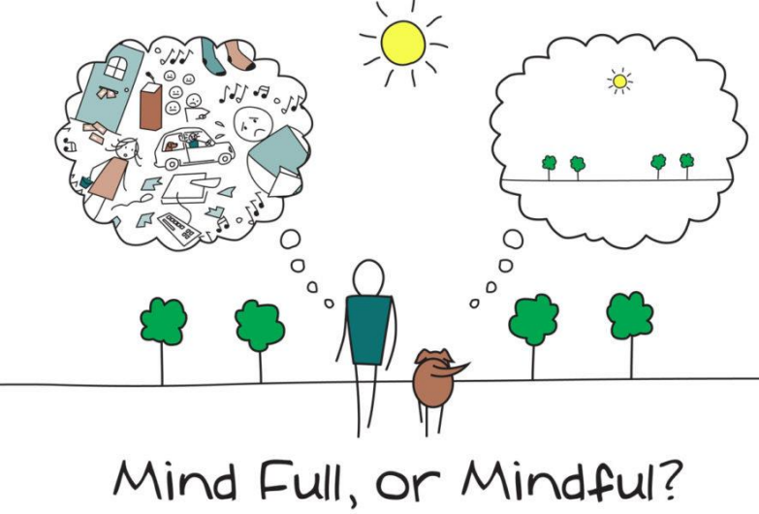
HELP workshops:
Being an international student – transitions, communication, well-being
23 February
22 March
26 April

Slide 11
Transitioning as a process of learning and growth
Adaptation
LANGUAGE
HABITS
UNI
SHOPPING
Growth over time
Stress
Based on: Kim, Young Yun. 2001. Becoming Intercultural: An Integrative Theory of Communication and Cross-Cultural Adaptation. Thousand Oaks, CA: Sage.

Slide 12
Stay well!
Enjoy your studies!

Slide 13
Thank you for your attention!
Dr. Uwe Pohl
Associate Professor, School of English and American Studies

