Slide 1
Starting the autum semester
Dr Attila STARCEVIC (Mr), Deputy Head of Dept of Int Affairs, Foundation Programme Coordinator
Ms Dóra SZABÓ, Foundation Programme Coordinator
Information Days, 6—9 September 2022

Slide 2
BEFORE WE BEGIN introducing the people you will meet
Your foundation programme coordinators:
Dr Attila STARCEVIC (deputy head of DIA, School of English and American Studies)
Dóra SZABÓ, international coordinator
Your director of studies:
Dr Kornél ZIPERNOVSZKY (English Foundation, International Study Centre)
Krisztina FÖLDINÉ SZŰCS (Hungarian foundation, Dept of Hungarian as a Foreign Language), interim director of studies
Orientation Days

Slide 3
EDUCATION AND TEACHING ARRANGEMENT
!
All classes start on campus
All happennings are in person on campus
!
!
The Epidemiological
Operative Coordinating Body (JOKT) constantly monitors the information on the spreading of the
virus, and it decides about measures accordingly
You will be informed on when and if classes go from on campus to online
!
Orientation Days

Slide 4
EDUCATION AND TEACHING ARRANGEMENT
!
The buildings of the faculty are open (library, offices, cafeterias, etc.)
All public venues in Hungary are open
!
!
Dormitories operate as usual; sick and infected persons are separated according to the house rules
Wearing a mask that covers your nose and mouth is currently not obligatory in communal spaces
!
Nevertheless, take the opportunity to be vaccinated and don’t shy away from using maks if you feel you need it for comfort
!
Orientation Days

Slide 5
STAYING ON THE SAFE SIDE: COVID vaccination, immunity certificates
+
Vacciantion is available for everyone in Hungary for free
Ask for it at https://vakcinainfo.gov.hu/
+
If you were vaccinated outside HU, immunity certificates can be requested in Kormányablak (allow for 15 days to come through)
EU certificates
certificates based on bilateral, unilateral agreements
based on serological test (only valid for 4 months)
Orientation Days

Slide 6
WELCOME & INFORMATION DAYS
+
Programme:
https://www.btk.elte.hu/welcome-to-our-new-students?_locale=en
+
Programmes with on campus experience:
Campus tour
ESN community programmes for students
Orientation Days

Slide 7
FOLLOW US ONLINE
Our homepage
btk.elte.hu
btk.elte.hu/welcome-to-our-new-students
Orientation Days

Slide 8
ONLINE PLATFORMS YOU MAY HAVE TO USE DURING STUDIES
Orientation Days

Slide 9
STUDY MATTERS

Slide 10
BREAKING NEWS
The University is adjusting the term’s schedule. The ongoing pandemic and the current energy crisis have made it necessary to be prepared for an eventual move to online learning.
One immediate change in the academic calendar is that the Autumn break is postponed until the end of the term. Any further changes will be announced through the usual information channels.
In the meantime, we recommend that students get equipped with the necessary technology for online learning, such as fast and reliable internet and a laptop computer.
Orientation Days

Slide 11
REGISTRATION
Registration is in-person in building A, room 31
(ground floor past the ATM machine to the left)
Book an appointment with us IF and ONLY IF you know you will be in Budapest at the chosen date (link already sent to those who filled in the arrival questionnaire)
Nyílt Nap | 2022. január 28.
Orientation Days

Slide 12
Documents NEEDED FOR registration
Bring the originals and photocopies as well
Orientation Days
Nyílt Nap | 2022. január 28.

Slide 13
What happens when today?
+
NOW you will hear a short introduction on your programme
+
You will find this ppt at
https://www.btk.elte.hu/welcome-to-our-new-students
+
IMMEDIATELY AFTER THIS short campus tour of the Int Study Centre
+
AT 4 PM TODAY big campus tour starting outside Múzeum körút 4
Orientation Days

Slide 14
What happens later in the week (or next week)?
+
Placement Tests (starting on 5 Sept)
Upon registration, we will forward your name and email to our teaching staff, they will be in touch regarding your placement test (keep checking your mail box, including the spam folder looking for instructions)
+
Registration
in person ongoing until 30 Sept (ask for appointment by writing to us at foundation@btk.elte.hu)
Orientation Days

Slide 15
Contents
+
Legal stay
Student ID
Bank account
Campus
Courses
Academic regulations / Absence policy
Technical and practical issues
Orientation Days

Slide 16
!
Stay here legally
Orientation Days

Slide 17
!
Keeping your stay legal National Directorate-General for Aliens Policing - OIF (Immigration and Asylum Office earlier)
Registration is a must
Orientation Days

Slide 18
!
If you are not required to have a student visa for entering Hungary, you must initiate registration as soon as you can at https://enterhungary.gov.hu/eh/?en
This is a procedure you must complete yourself. This is how you will obtain your residence permit.
Orientation Days

Slide 19
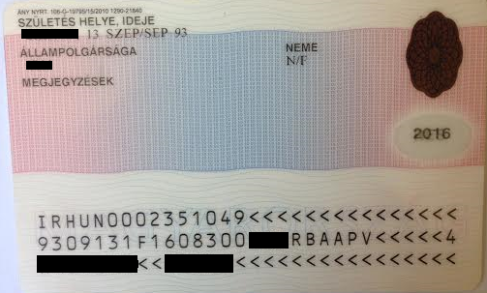
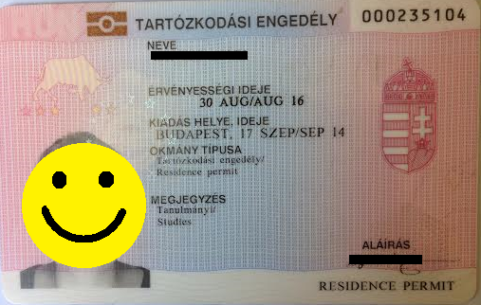
!
Your Residence Permit
Orientation Days

Slide 20
!
Keeping your stay legal
!
Keep your active student status
Keep us informed at all times about changes
Report all emergencies affecting your status
Request information from us if you have any doubts or questions
Orientation Days

Slide 21
!
Keeping your stay legal Active vs. Passive Status
!
By registering in person you have obtained your active student status
In case you need to leave Hungary temporarily (due to a medical emergency in your home country), it is your duty to inform us about your departure
It is absolutely forbidden to have active status while you do not attend any of your classes. Students who are active and do not attend classes will be reported to the relevant authorities and there is no refunding of your tuition fees
Orientation Days

Slide 22
!
Picking up your residence permit: we are working with the Immigration Office on setting up pick-up points on the faculty
!
More on this later: September, beginning of October
Orientation Days

Slide 23
+
Student ID (Student card)
+
Where?
Quaestura Office Services (not the Faculty), see for details at https://qter.elte.hu/default.aspx
+
What do they do? Issuing of
Neptun code and password
Certificate of Student Status (active/passive)
Student ID (NOTE: do not ask for your student ID from us, we do not issue them)
Arranging for Health Insurance
Orientation Days

Slide 24
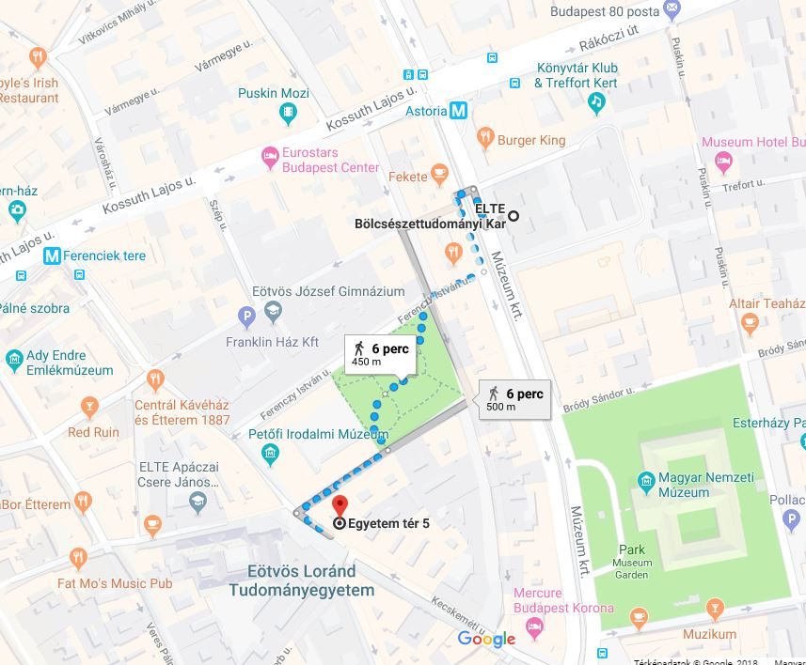
+
Orientation Days

Slide 25
+
Student ID Students staying for shorter than 12 months
+
Temporary Student ID paper (not a plastic card)
Issued by Quaestura Office
Show identification
Know your Neptun Code and password
DO NOT forget: the ID is valid for up 60 days, must renew it regularly (for end date check point 6 on the paper card)
Orientation Days

Slide 26
+
Student ID/Card Is Good For What? Discounted transportation in Budapest
+
Points to remember:
ALWAYS carry your student ID with you + your montly pass
Monthly discounted pass: 3450 HUF
Your student ID card number is necessary for the pass to be valid
Orientation Days

Slide 27
+
Further Points to Remember
You must have a validated (punched/time stamped) ticket or a valid monthly pass on the vehicles (DO NOT get on vehicles without this)
BKK officials are authorized to check the validity of your ticket or pass any time during or after your trip
Passengers without valid ticket or pass are to pay a heavy fine - 16.000,- HUF (approx. 55 EUR) if paid by check
If you do not yet have your student ID, buy a full priced monthly pass (9500 HUF) for a month, after that use your student ID
Orientation Days

Slide 28
+
Finances
+
First-year-students: before enrolment
After the first semester:
deadline – last day of the registration period (end of first week of February/September)
+
Payment details & tuition fees: https://btk.elte.hu/fees-and-finances
Orientation Days

Slide 29
+
Every Detail Counts
Messages / Közlemény (in Hungarian): AC9201/04
For example (follow this order):
John Smith
AC9201/04
2022/23 Aut
English Foundation
What happens if you forget the magic number (AC9201/04)? There will be a delay in our system showing your payment and you can expect to get emails from us asking you why you are late with your payment
Orientation Days

Slide 30
+
Open a bank account in Hungary
+
Scholarship holders (SH, Diaszpóra):
you have to own a bank account in Hungary
Orientation Days

Slide 31
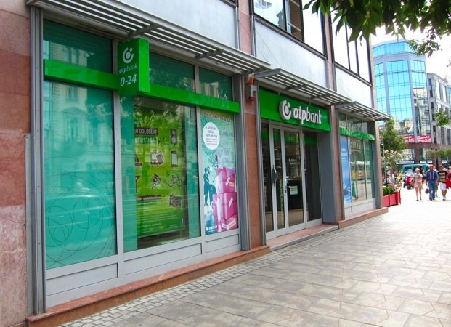
+
Open a bank account in Hungary
+
You can open an account at any bank
Closest bank:
near Astoria (campus): Károly krt. 1
Orientation Days

Slide 32
+
Buy a Hungarian SIM card
+
Choose from a variety of providers:
- Yettel: (closest to the campus: Károly krt. 3/a, 1075 Hungary)
- Vodafone
- Telekom
Orientation Days

Slide 33
+
Summary
+
- Health Insurance:
A) Scholarship holders: Covered (must have a TAJ szám/number, go to Quaestura for assistance)
B) Self-payed students: Buy an insurance policy in Quaestura (Egyetem tér 5., 1053 Bp)
- Student Card: Quaestura (after registration)
- Mobile Phone/SIM Card: Yettel, Vodafone, Telekom (find your provider, google your nearest spot, go to a shopping mall)
Orientation Days

Slide 34
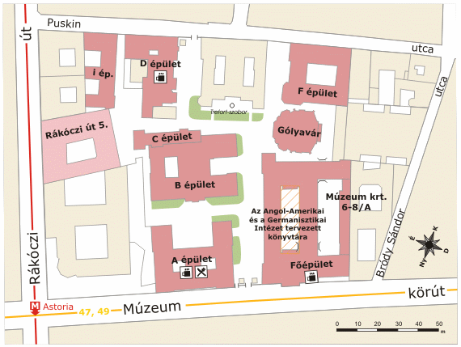
Campus
Orientation Days

Slide 35
Where is Your Dept of Int Affairs (DIA)?
Múzeum krt. 4/A
1088 Budapest
Ground floor, room 31
(Attila STARCEVIC and
Dóra SZABÓ)
Orientation Days

Slide 36
How Do I Contact DIA?
By email: foundation@btk.elte.hu
During Our Office Hours
(not earlier, not later):
Monday: 13.00-16.00
Tuesday: no office hours
Wednesday: 13.00-16.00
Thursday: no office hours
Friday: 9.00-12.00
Orientation Days

Slide 37
Courses
Registration Week:
5—9 Sept
Last Day to Register for Aut 2022:
30 Sept 2022
Study Period: 12 Sept until mid Jan 2023
Exam Period: End of January for mid terms (details to follow)
Itemised calendar: https://btk.elte.hu/dstore/document/5605/calendar.pdf
Orientation Days

Slide 38
Course registration period
In the foundation programme, DIA enters your courses into NEPTUN
Why?
There is no cherry picking, you must take (and hopefully pass) ALL your subjects and
Which course you attend depends on your level of language proficiency and
Some of you may arrive after the course registration period ends and NEPTUN shuts down
Orientation Days

Slide 39
Exams
We will register your mid term exams for you.
This will happen in January…
Orientation Days

Slide 40
A few interesting facts about subjects and courses
Always check the study unit list / curriculum at
https://btk.elte.hu/en/content/foundation-programmes.t.3437?m=245
Find it under your programme → List of study units
The list of study unit shows:
Code of the subject
Title of the course
Credits
Recommended semester
Prerequisites
Orientation Days

Slide 41
How to sign up for the courses?
In NEPTUN, but in the foundation year DIA enters your courses into NEPTUN. You will be able to check your timetable in NEPTUN after all courses have been registered
Orientation Days

Slide 42
Which Platform will I Need for Online Classes?
Microsoft Teams (MS Teams)
Download it free from the web on your platform
Your teachers will contact you from there
Which device can I use for my classes?
Laptop (+ microphone + camera), phones are not allowed
Orientation Days

Slide 43
Institutional websites
You will find more information (e.g., the timetables) at:
https://btk.elte.hu/en
Find Education
Find Foundation programmes
(find EN, DE or HU)
Orientation Days

Slide 44
Academic Regulations / Absence Policy
Academic calendar:
https://www.elte.hu/en/academic-calendar
Orientation Days

Slide 45
Academic Regulation #0: your reason for being at the University
You are here to study in an academic programme, not miss classes, be chronically late for classes, work full time, work when you are supposed to be in class, etc.
The Foundation Programme is a ’package’, all courses must be taken together, there is NO picking and choosing
Orientation Days

Slide 46
Academic Regulation #1: Getting Grades for Your Courses
by the end of semester (end of June) you must have at least 1 completed subject (with a grade better than 1 ‘fail’)
in case you do not, an official letter will be sent out calling you before a committee to explain your results
if you do not respond to this, we will contact the authorities
Orientation Days

Slide 47
Academic Regulation #2: Reporting Absences
you are here to complete your programme (= study), not miss classes, so
inform your teacher in advance of any absences, providing an acceptable reason
if your absence is caused by an emergency, you should contact your teacher afterwards, providing an acceptable reason
contacting your teachers in advance (or later) does not mean you are exempted
Orientation Days

Slide 48
Academic Regulation #3: Absence Policy
(based on University Regulations adapted to the foundation programme, read in full: https://btk.elte.hu/en/content/absence-policy-for-the-foundation-programmes.t.4220?m=305, a copy of which you will sign in acceptance of its content)
if you miss more than 30% of your classes in one subject within a period of 4 weeks, you will not get a grade and you will not receive any credit for any of your courses.
Consequences:
we will turn your status passive
we will forward your case to the National Directorate-General for Aliens Policing: your residence permit is issued for education
if you miss your classes in one or more subjects for 2 weeks in a row, an official letter will be sent out calling you before a committee to explain your absence from classes; if you come and explain the cause of your absences you might get a chance to stay active but you cannot miss any more classes. If you do not respond,
we will forward your case to the National Directorate-General for Aliens Policing: your residence permit is issued for education
Orientation Days

Slide 49
Academic Regulation #4: Failed Subjects, Retakes
If you fail a subject in the 1st semester, can you retake it in the 2nd semester?
No. Why?
Because they are not given in the 2nd semester
Orientation Days

Slide 50
Consequences of your absences (summary)
Your status will be passive
All your courses will be deleted from neptun
There will be no classes, no grades, no credits
There will be no exams
There is no refund of your tuition fee at all
We will have to forward your name to the Immigration Office (after this you may find it difficult to renew your reidence permit in case you stay in Hungary, even if you have been admitted to another university)
Orientation Days

Slide 51
Academic Grading system
Five-point scale:
And excellent (5) grade is assigned to the student who thoroughly knows the entire subject matter in all of its inherent relationships and is able to independently apply his/her knowledge with absolute certainty;
A good (4) grade is assigned to the student who thoroughly knows the entire subject matter of the course and can safely apply its content;
A satisfactory (3) grade is assigned to the student who knows significant portions of the subject matter of the course and is able to apply them with suitable safety;
A pass (2) grade is assigned to the student who knows the significant parts of the course on a satisfactory level and is able to demonstrate an acceptable level of familiarity in the application of the content of the course;
A fail (1) grade is assigned to the student who does not command sufficient knowledge and demonstrate skill in applying the practices of his/her chosen field.
Orientation Days

Slide 52
What happens at the end of the spring semester next year if you pass ALL your subjects during the course of your 2 semester programme?
You will get a credit certificate (stating all the credits you completed)
And
A certificate of achievement stating your achievement in % based on the end of year exam in January. The type of certificate depends on whether you pass all the courses or just some, as well as the level of your achivement and the programme you have completed:
English: levels below B2 will not be shown in the certificate (such certificates will not be issued)
Hungarian / Hungarian: all levels will be shown (B1, B2, C1)
Orientation Days

Slide 53
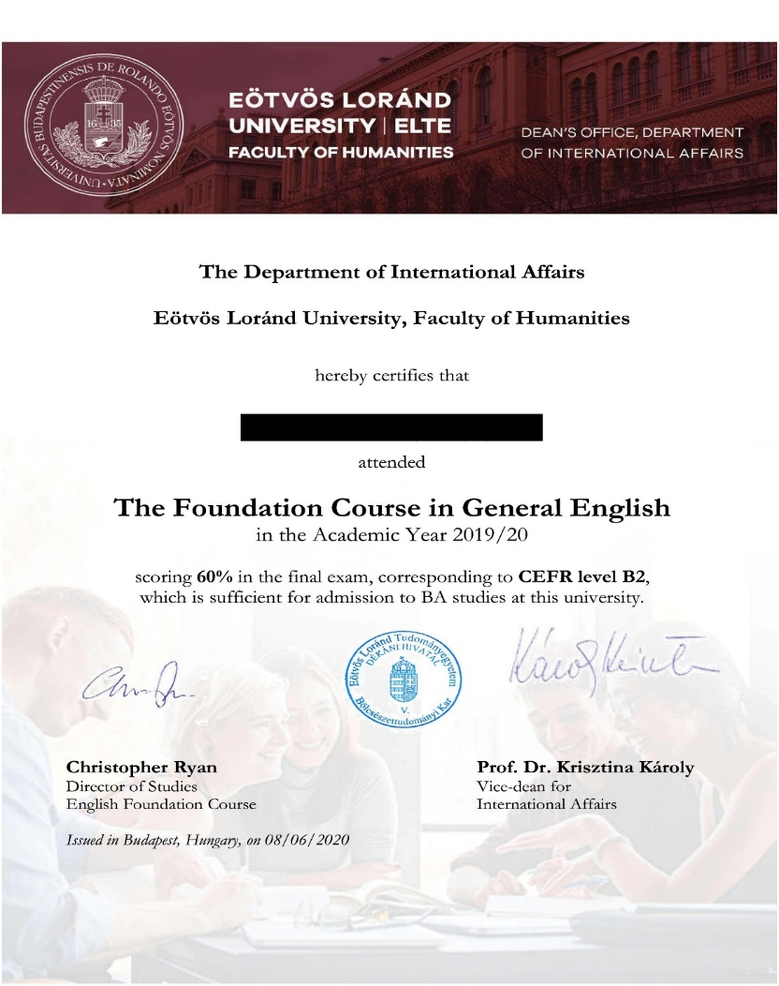
Sample Certificate
Orientation Days

Slide 54
What’s there in a certificate for you?
If you achieve B2 level of CEFR, you will get from us an offer (letter of acceptance/LOA) for autumn semester in
BA in English and American Studies
BA in Hungarian
There is no admission procedure, no entrance exam, no questions asked. Of course, you can choose not to start your programme. The letter of acceptance is valid for one autumn semester only.
There is no LOA for a spring semester, even if you finish the programme next Feb. You will have to wait until July to get your LOA for September.
To inquire about whether our certificate is accepted as proof of language competence at other universities, make inquiries at the university of your choice.
Orientation Days

Slide 55
Registration and picking a time slot
In Person Registration (for those who can come to see us by 30 Sept):
please pick time slot at (if you haven’t already):
https://docs.google.com/spreadsheets/d/129LcixeU9W-51CquHuPqxVIHZeseiGTDrxmTqUG4kLY/edit#gid=1228398188
Online Registration: Not available
Orientation Days

Slide 56
Documents needed for on campus personal registration
Letter of Acceptance received from ELTE
Confirmation of Payment document of your tuition fee received from ELTE and/or the copy of your bank slip (if you have not received the confirmation of payment)
Passport
your original Certificate of Matriculation (graduation certificate from high school studies)
your Hungarian address (zip code, city, name of the public place, floor, door number)
Your Hungarian phone number
student visa page
2 passport photo (colour) – Write your full name at the back with capital letters
Orientation Days

Slide 57
Some important facts about your tuition fee
After your completed (in person) registration, you are an active student of the University. Interrupting your legal status as an active student is a serious matter. It can only be requested on grounds of poor health or a serious family emergency. You will have to write to us to request this.
NOTE
About deadlines on possible refund cases read our 2nd information letter (sent to your email address given in Dream Apply)
Orientation Days

Slide 58
Technical issues, and other practical matters
Use Wi-Fi at the campus
You can use the wi-fi at the university if you ask for a username and password.
For requiring a username and a password, you need your Neptun ID (code) and password
On how to ask for the wi-fi and set it up:
Step 1. IIG ID: https://www.elte.hu/en/it-support
Step 2. Setting up the Wi-Fi conenction: https://btk.elte.hu/en/content/it-support.t.5128?m=350
Orientation Days

Slide 59
Copy shops
Building R on the campus (Rákóczi út 5) or
Kálvin square, 5-8 min walk from the campus:
Mini Copy
Copy Guru
Orientation Days

Slide 60
What happens now?
'small' tour of the International Study Centre (the place of your classes) -- NOW, DON'T GO AWAY
'big' tour: at 4 pm (given by the Students' Union) of the whole of the campus, COME BACK, be at the big gates outside Múzeum körút 4
Orientation Days

Slide 61
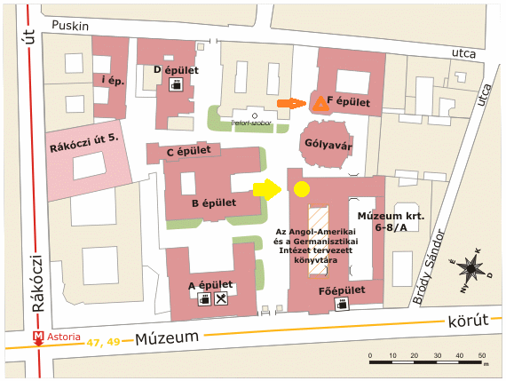
Small tour covers the place of your classes (International Study Centre)
Orientation Days

Slide 62
Thank you for your attention
Enjoy your semester with us
btk.elte.hu
facebook/eltebtkbudapest
instagram/elte_btk

